Slide 1
Topic Modeling, Machine Learning Ethics
David Quigley
CSCI 5622
2021 Fall

Slide 2
Tuesday

Slide 3
Course Logistics
Problem Set 4 Due 11/18
Project Pitch Feedback – it’s late now!
We really just want everyone to get feedback. You have a 0 and an email, but if you send it in you’ll get credit!
Project 3: Check-In is now posted (Due November 11)
This is a small activity as well! Don’t freak out over it, it should feel like it is nothing but beneficial.
Participation Grades Updated – Check if you disagree!
Don’t freak out if you missed one – remember, you drop the lowest three!

Slide 4
NLP Primer
Or – Everything* You Need To Know About Natural Language Processing
*just kidding – go take 5832 if this sparks your interest!

Slide 5
NLTK – the SKLearn of NLP
https://www.nltk.org/

Slide 6
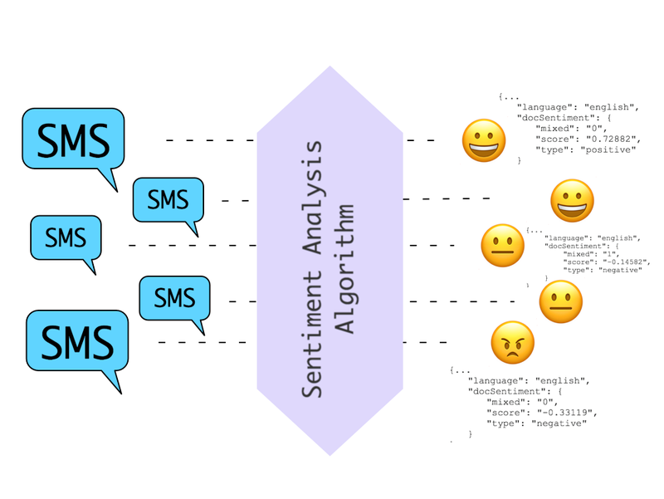
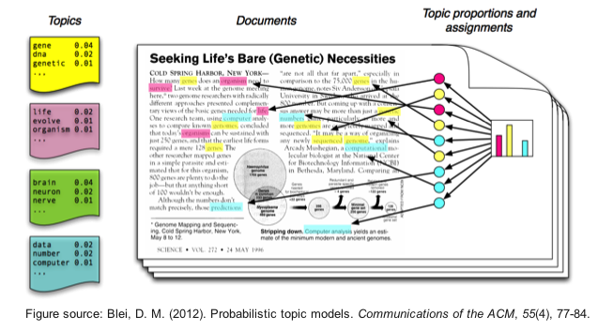

Natural Language Processing – Applications
Sentiment Analysis Topic Modeling
Translation
Notes:
https://machinelearningmastery.com/applications-of-deep-learning-for-natural-language-processing/
https://s3.amazonaws.com/com.twilio.prod.twilio-docs/images/SentimentAnalysis.width-800.png
http://bigdata.ices.utexas.edu/wp-content/uploads/2015/01/LDA-concept.png
https://www.fbi.gov/image-repository/translation-keyboard-stock.jpg/@@images/image/large

Slide 7
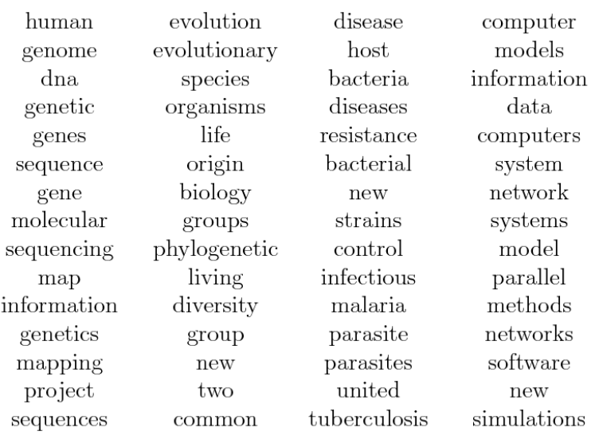
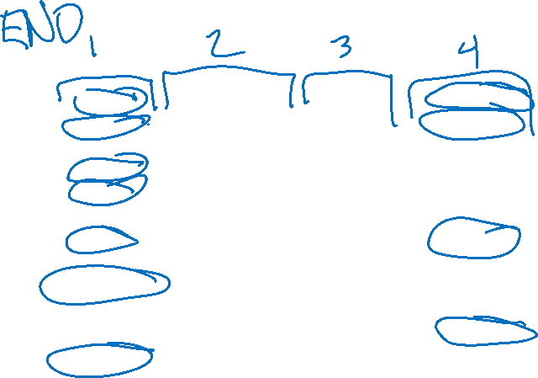
Topic Modeling
Clustering Technique
Associate similar documents
Example: Topics in Science

Slide 8
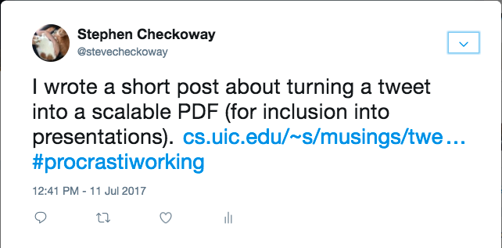
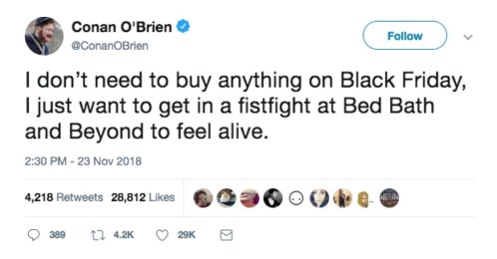
NLP Primer – Documents
Notes:
https://checkoway.net/assets/posts/tweet-images/tweet.png
https://i0.wp.com/bestlifeonline.com/wp-content/uploads/2018/12/conan-tweet.jpg?fit=498%2C260&ssl=1

Slide 9
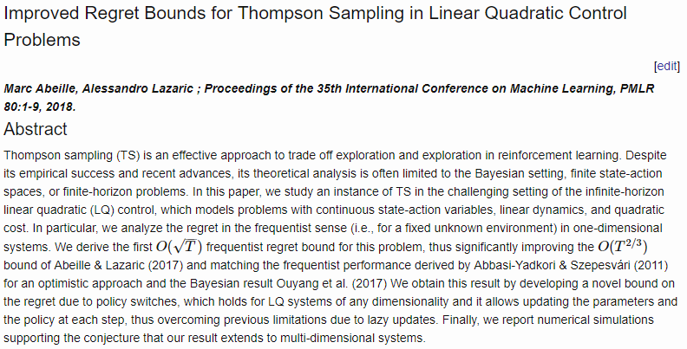
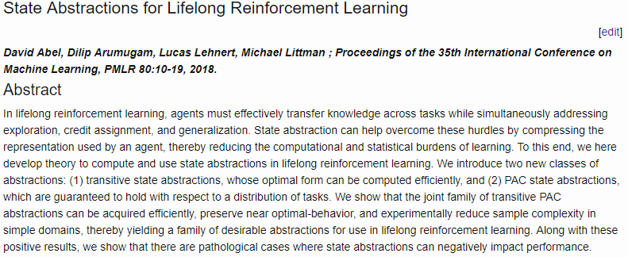
NLP Primer – Documents
Notes:
https://checkoway.net/assets/posts/tweet-images/tweet.png
https://i0.wp.com/bestlifeonline.com/wp-content/uploads/2018/12/conan-tweet.jpg?fit=498%2C260&ssl=1
http://proceedings.mlr.press/v80/abeille18a.html
http://proceedings.mlr.press/v80/abel18a.html

Slide 10
NLP Primer – Documents
Your definition of a “document” may vary, but it’s essentially one example in your problem!
- Tweet
- Article
- Paragraph
- Short-answer Response
Notes:
https://checkoway.net/assets/posts/tweet-images/tweet.png
https://i0.wp.com/bestlifeonline.com/wp-content/uploads/2018/12/conan-tweet.jpg?fit=498%2C260&ssl=1
http://proceedings.mlr.press/v80/abeille18a.html
http://proceedings.mlr.press/v80/abel18a.html

Slide 11
NLP Primer – Documents
Your definition of a “document” may vary, but it’s essentially one example in your problem!
- Tweet
- Article
- Paragraph
- Short-answer Response
Let’s look at clustering tweets
Notes:
https://checkoway.net/assets/posts/tweet-images/tweet.png
https://i0.wp.com/bestlifeonline.com/wp-content/uploads/2018/12/conan-tweet.jpg?fit=498%2C260&ssl=1
http://proceedings.mlr.press/v80/abeille18a.html
http://proceedings.mlr.press/v80/abel18a.html

Slide 12
NLP Primer – Documents into Features
Extracting metadata features
- references (retweets, links, other articles)
- author / source

Slide 13
NLP Primer – Documents into Features
Cleaning & Preparing Text
- Tokenization

Slide 14
NLP Primer – Tokenization
Breaking down block of text into subtexts
Typically filtering out all punctuation
- Or you include it as a token in the series
Notes:
http://blog.xnextcon.com/wp-content/uploads/2018/04/1.jpeg

Slide 15
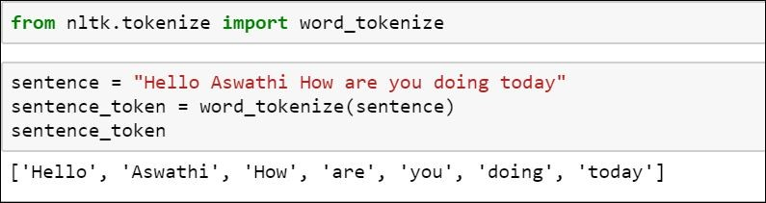

NLP Primer – Tokenization
Breaking down block of text into subtexts
Typically filtering out all punctuation
- Or you include it as a token in the series
May need to retain other structures (e.g. translation)
Notes:
http://blog.xnextcon.com/wp-content/uploads/2018/04/1.jpeg

Slide 16
NLP Primer – Documents into Features
Cleaning & Preparing Text
- Tokenization

Slide 17

NLP Primer – Documents into Features
Cleaning & Preparing Text
- Tokenization
- Removing Unhelpful Words

Slide 18

NLP Primer – Articles & Other Stopwords
Articles – clarifying words on nouns, providing specificity
- I found the bat
- I found a bat
Conjunctions – combining two clauses
- I love everything but sushi
- I love everything and sushi

Slide 19
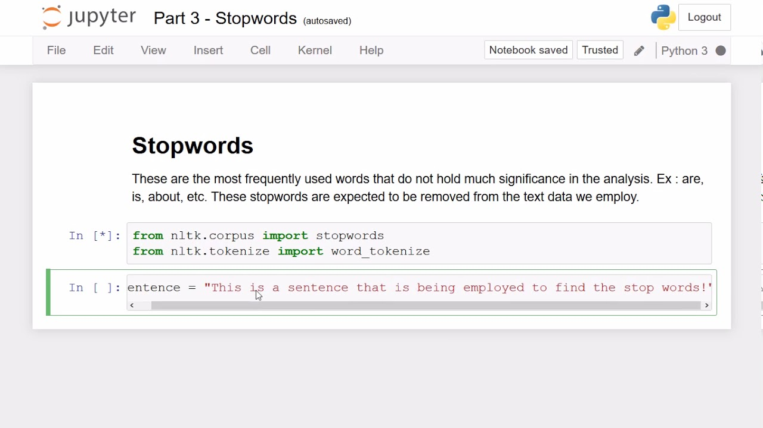
NLP Primer – Articles & Other Stopwords
Articles – clarifying words on nouns, providing specificity
- I found the bat
- I found a bat
Conjunctions – combining two clauses
- I love everything but sushi
- I love everything and sushi
Notes:
https://i.ytimg.com/vi/AJg0r_b6pYs/maxresdefault.jpg

Slide 20
NLP Primer – Articles & Other Stopwords
Articles – clarifying words on nouns, providing specificity
- I found the bat
- I found a bat
Conjunctions – combining two clauses
- I love everything but sushi
- I love everything and sushi
Your removal needs may vary
- e.g. translation, sentiment
Notes:
https://i.ytimg.com/vi/AJg0r_b6pYs/maxresdefault.jpg

Slide 21
NLP Primer – Documents into Features
Cleaning & Preparing Text
- Tokenization
- Removing Unhelpful Words

Slide 22
NLP Primer – Documents into Features
Cleaning & Preparing Text
- Tokenization
- Removing Unhelpful Words
- Lemmatization & Stemming

Slide 23
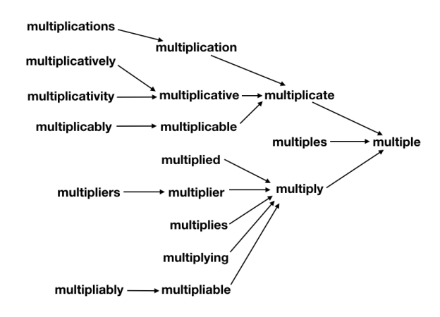

Lemmatization & Stemming
Lemmatizing – setting things in a matched tense, person, etc.
- tossed → toss
- ran → run
Stemming – Converting words to their root (stem) word
- tossed → toss
- stemming → stem
Notes:
https://searchingforbole.files.wordpress.com/2018/01/re-learning-english-multiple1.png?w=624

Slide 24
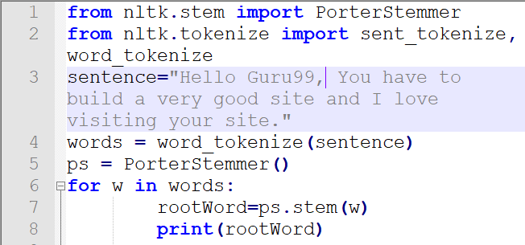

Lemmatization & Stemming
Lemmatizing – setting things in a matched tense, person, etc.
- tossed → toss
- ran → run
Stemming – Converting words to their root (stem) word
- tossed → toss
- stemming → stem
Notes:
https://www.guru99.com/images/1/100118_0649_Stemmingand2.png

Slide 25
Lemmatization & Stemming
Lemmatizing – setting things in a matched tense, person, etc.
- tossed → toss
- ran → run
Stemming – Converting words to their root (stem) word
- tossed → toss
- stemming → stem
Your needs may vary
- translation
Notes:
https://www.guru99.com/images/1/100118_0649_Stemmingand2.png

Slide 26
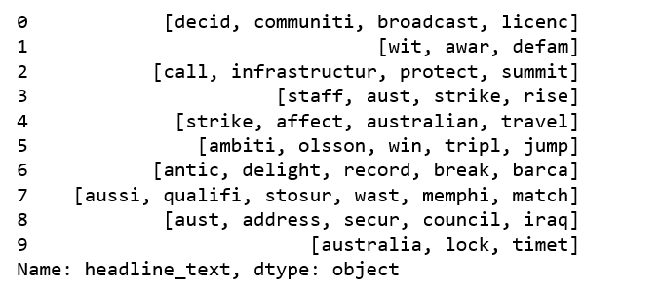

NLP Primer – Documents into Features
A words array for each entry

Slide 27
NLP – Analysis Approaches
Bag-of-words – each document is just a collection of words, dropping all reference to order, etc.

Slide 28
NLP – Analysis Approaches
Bag-of-words – each document is just a collection of words, dropping all reference to order, etc.
N-Gram Models – Each set of N words is treated as an entry

Slide 29
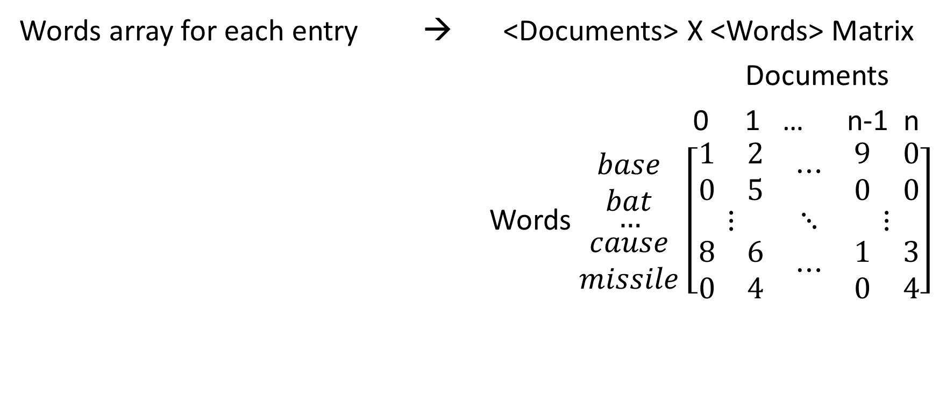

Topic Modeling – Vectors to Matrix
Words array for each entry → <Documents> X <Words> Matrix
Documents
0 1 … n-1 n
Words $\begin{matrix}\begin{matrix}base \\ bat\end{matrix} \\ … \\ \begin{matrix}cause \\ missile\end{matrix}\end{matrix}$ $\left[\begin{matrix}\begin{matrix}1 & 2 \\ 0 & 5\end{matrix} & ⋯ & \begin{matrix}9 & 0 \\ 0 & 0\end{matrix} \\ ⋮ & ⋱ & ⋮ \\ \begin{matrix}8 & 6 \\ 0 & 4\end{matrix} & ⋯ & \begin{matrix}1 & 3 \\ 0 & 4\end{matrix}\end{matrix}\right]$

Slide 30
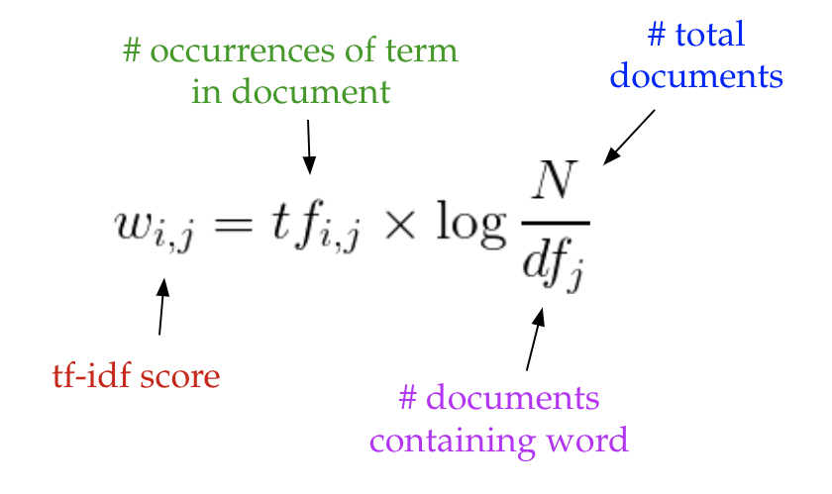
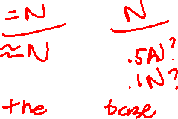
Adjusting the Matrix – TF-IDF
term frequency-inverse document frequency
Notes:
https://medium.com/nanonets/topic-modeling-with-lsa-psla-lda-and-lda2vec-555ff65b0b05

Slide 31
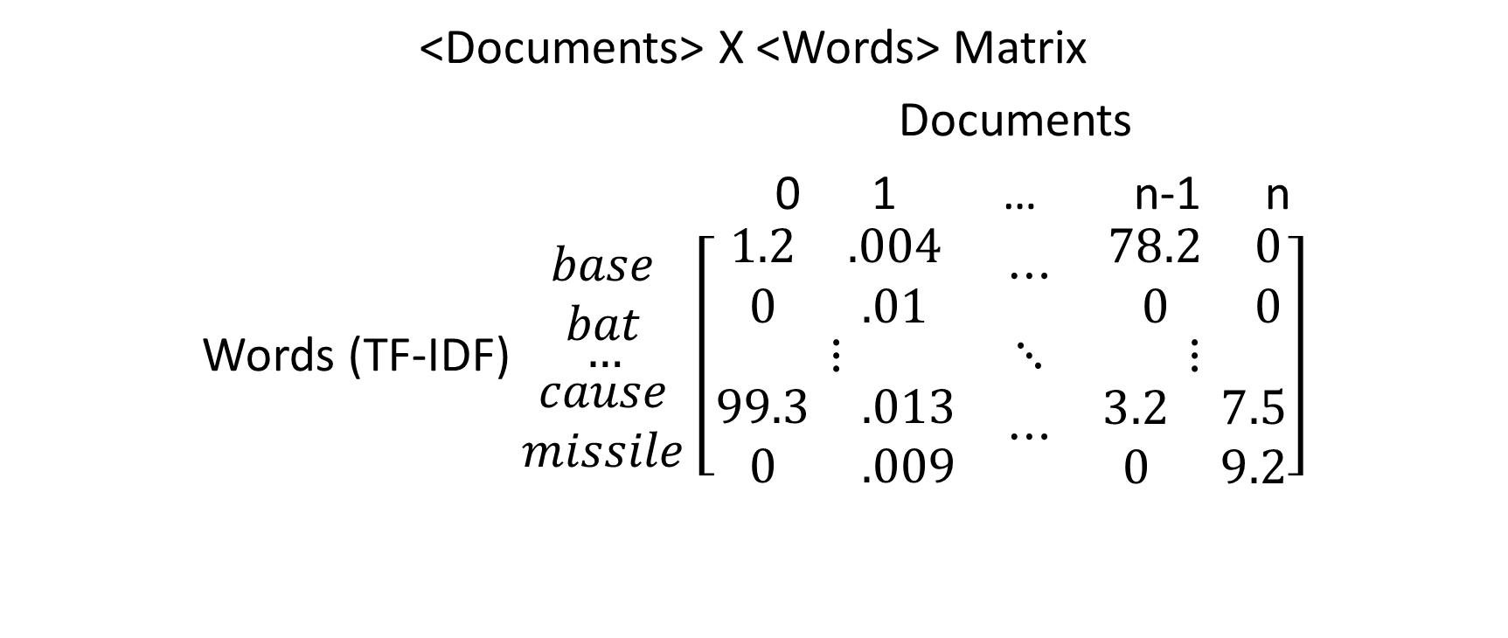
Topic Modeling – Vectors to Matrix
<Documents> X <Words> Matrix
Documents
0 1 … n-1 n
Words (TF-IDF) $\begin{matrix}\begin{matrix}base \\ bat\end{matrix} \\ … \\ \begin{matrix}cause \\ missile\end{matrix}\end{matrix}$ $\left[\begin{matrix}\begin{matrix}1.2 & .004 \\ 0 & .01\end{matrix} & ⋯ & \begin{matrix}78.2 & 0 \\ 0 & 0\end{matrix} \\ ⋮ & ⋱ & ⋮ \\ \begin{matrix}99.3 & .013 \\ 0 & .009\end{matrix} & ⋯ & \begin{matrix}3.2 & 7.5 \\ 0 & 9.2\end{matrix}\end{matrix}\right]$

Slide 32
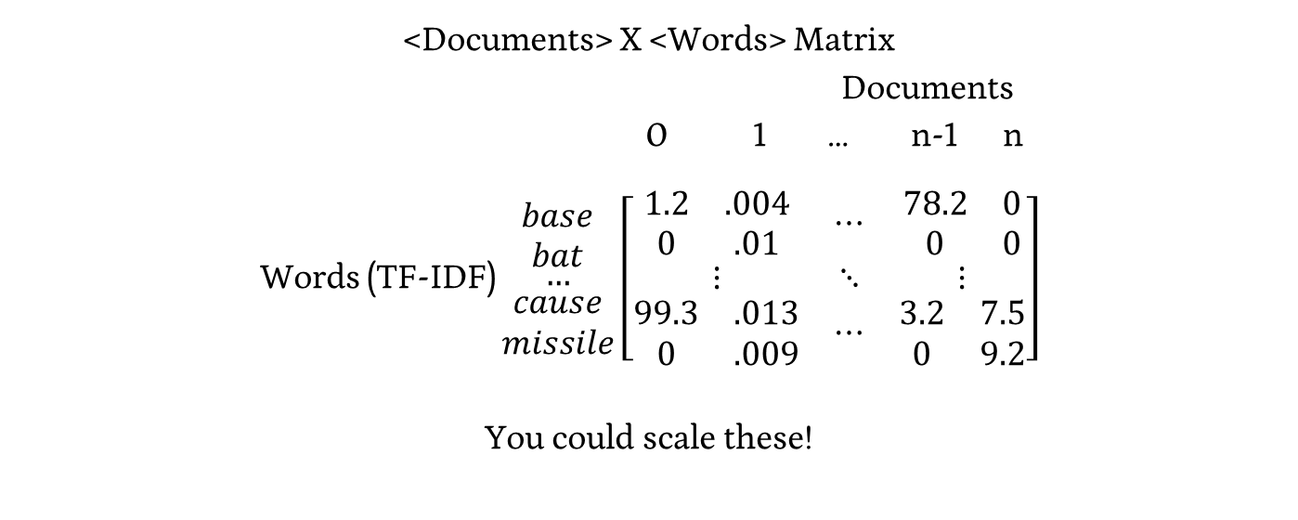

Topic Modeling – Vectors to Matrix
<Documents> X <Words> Matrix
Documents
0 1 … n-1 n
Words (TF-IDF) $\begin{matrix}\begin{matrix}base \\ bat\end{matrix} \\ … \\ \begin{matrix}cause \\ missile\end{matrix}\end{matrix}$ $\left[\begin{matrix}\begin{matrix}1.2 & .004 \\ 0 & .01\end{matrix} & ⋯ & \begin{matrix}78.2 & 0 \\ 0 & 0\end{matrix} \\ ⋮ & ⋱ & ⋮ \\ \begin{matrix}99.3 & .013 \\ 0 & .009\end{matrix} & ⋯ & \begin{matrix}3.2 & 7.5 \\ 0 & 9.2\end{matrix}\end{matrix}\right]$
You could scale these!

Slide 33
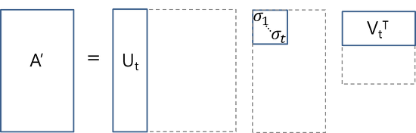
Topic Modeling – Matrix to Topics
Matrix Representation of Documents & Terms

Slide 34
Topic Modeling – Matrix to Topics
Matrix Representation of Documents & Terms
Think of this as a generative process – Terms → Topics → Documents

Slide 35

Topic Modeling – Matrix to Topics
Matrix Representation of Documents & Words
Think of this as a generative process – Words → Topics → Documents
Docs X Words Topics X Words Topics Docs X Topics

Slide 36
Topic Modeling - SVD
SVD transforms our matrix A’ into it’s constituent parts

Slide 37
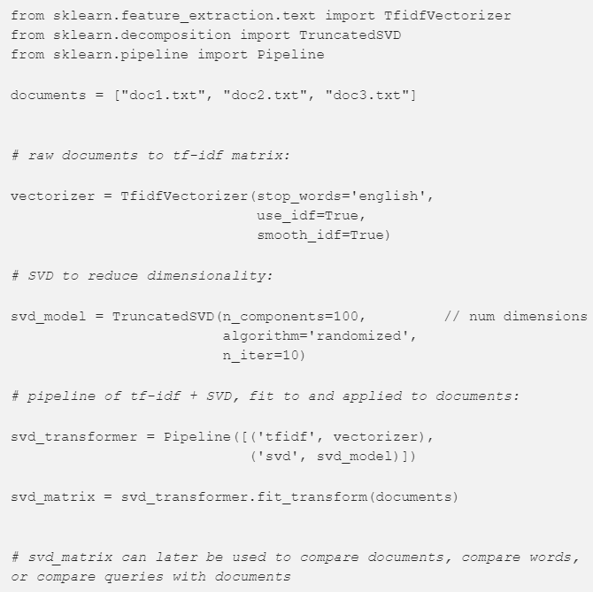

Latent Semantic Analysis (LSA) in SKLearn
https://medium.com/nanonets/topic-modeling-with-lsa-psla-lda-and-lda2vec-555ff65b0b05

Slide 38

Practicing With Topic Modeling
https://www.usna.edu/Users/cs/nchamber/data/twitter/

Slide 39
Ethics in Machine Learning
i.e. Everything You Need To Know About Being Good
Notes:
https://www.colorado.edu/philosophy/2018/11/02/new-course-ethics-and-information-technology-phil-2160

Slide 40
Ethics in Machine Learning
i.e. Everything You Need To Know About Being Good
PHIL 2160 or ???
Notes:
https://www.colorado.edu/philosophy/2018/11/02/new-course-ethics-and-information-technology-phil-2160

Slide 41
Ethics Discussion Disclaimer
This is an inherently personal and interpersonal topic
- Personal ideals, beliefs, and understandings of truth come into play
I will try to be unbiased, present different ideas and facts
- I may, from time to time, take extreme / indefensible views to foster discussion
This is an open space for disagreement and discussion
- i.e. please, call me out on it

Slide 42
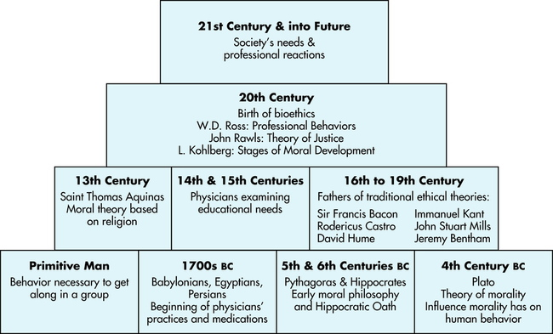
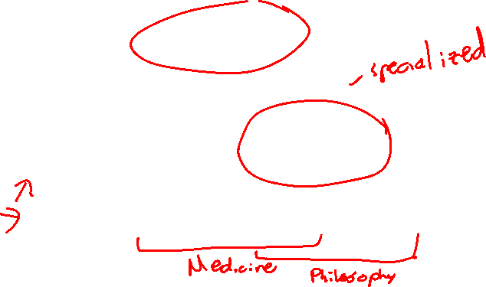
History of Ethics
Notes:
https://radiologykey.com/ethical-and-legal-foundations/

Slide 43
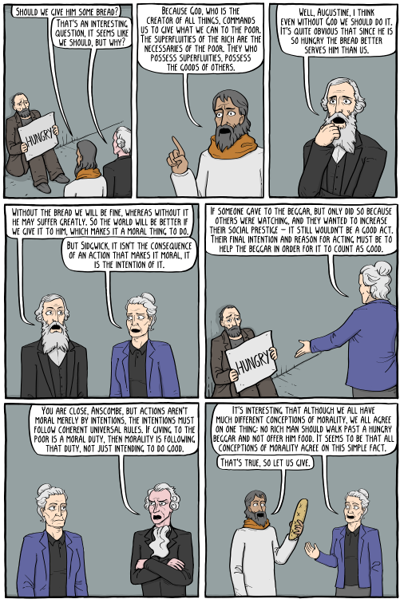

Moral Theories
Divine Command
- Ethics are mandated by divine
- Saint Augustine
Utilitarianism
- Ethics are related to the consequences
- Henry Sidgwick
Virtue Ethics
- Ethics are internal motivation
- Elizabeth Anscombe
Deontology
- Ethics are a shared set of rules
- Immanuel Kant http://existentialcomics.com/comic/258

Slide 44
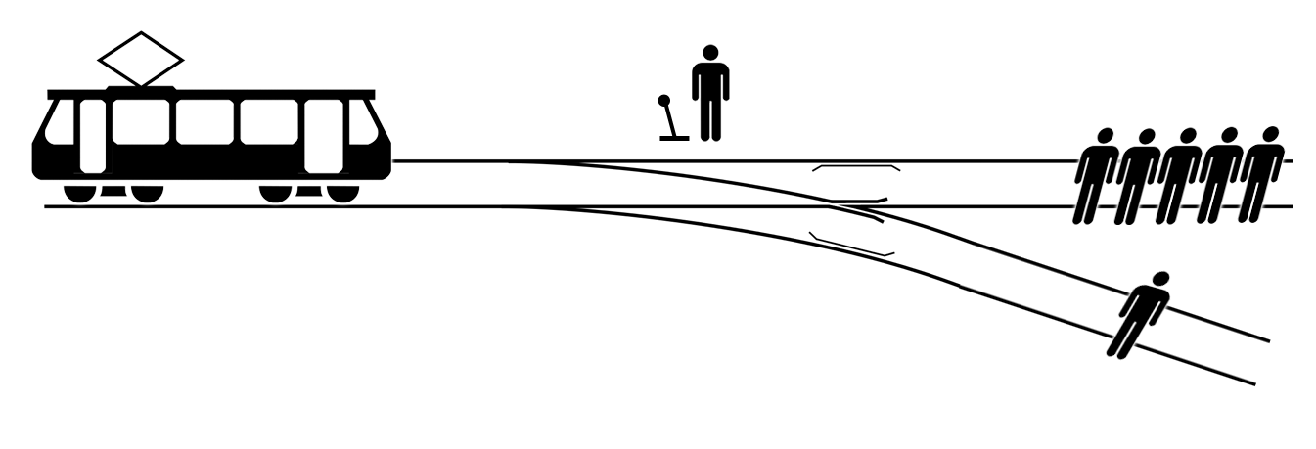
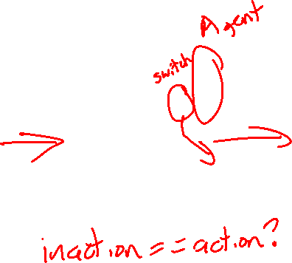
The Trolley Problem
Notes:
https://upload.wikimedia.org/wikipedia/commons/8/8c/Trolley_problem.png

Slide 45
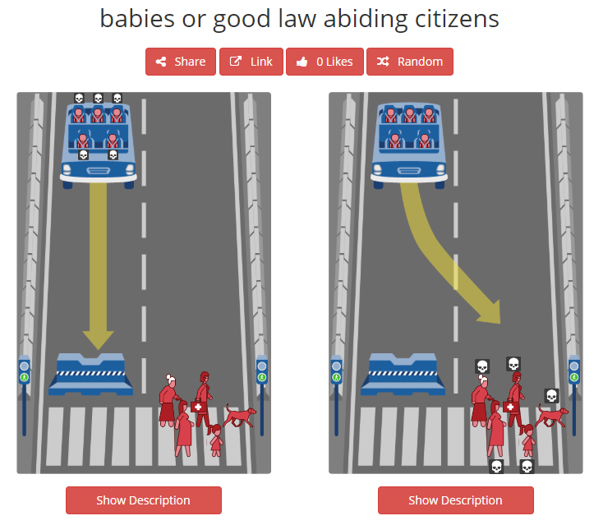

Case Study 1 – Moral Machines
http://moralmachine.mit.edu/
- judge (they collect data) or browse (ostensibly, they don’t)

Slide 46
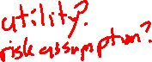
Case Study 1 – Moral Machines
Theories
Divine Command
Utilitarianism
Virtue Ethics
Deontology
Our Thoughts?
How might this change your actions?

Slide 47
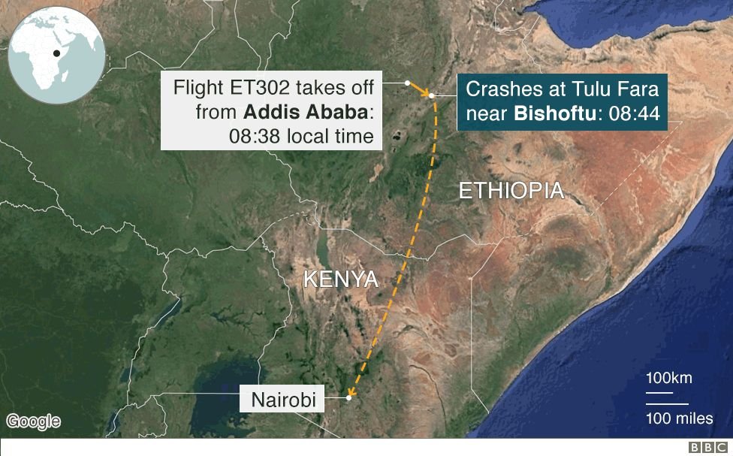
Case Study 2 – Boeing 737 MAX Crashes
Notes:
https://www.bbc.com/news/world-africa-47553174

Slide 48
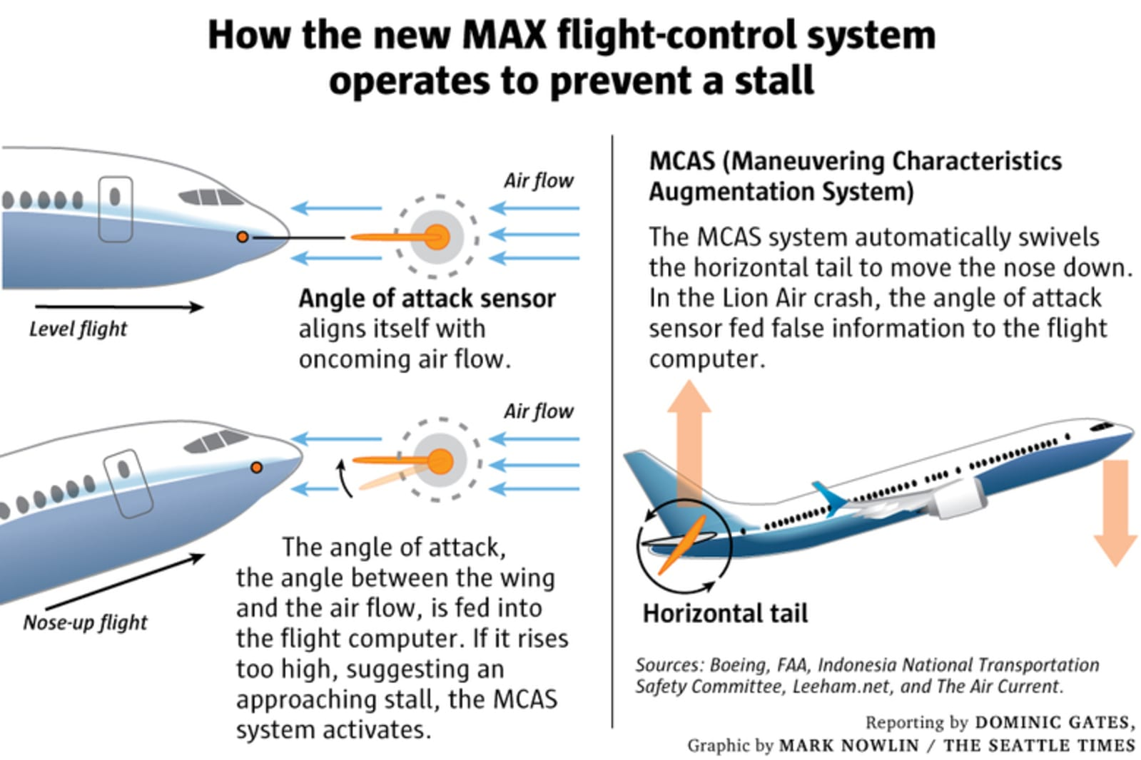


Slide 49
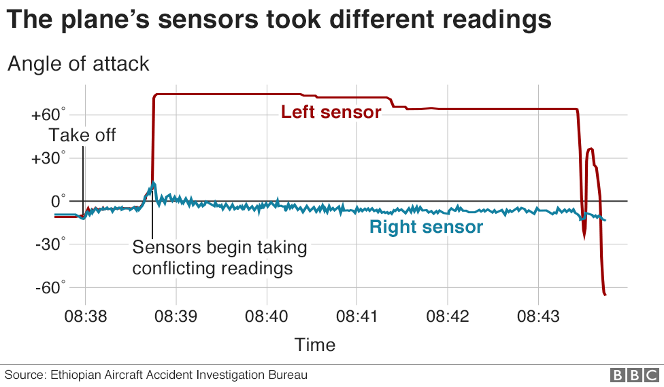

Notes:
https://www.bbc.com/news/world-africa-47553174

Slide 50
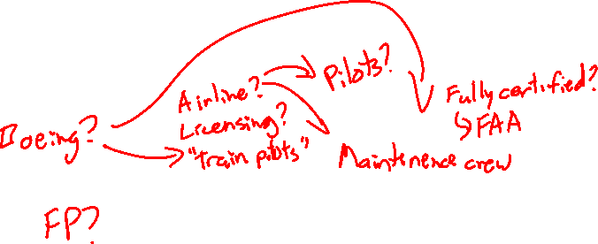
Case Study 2 – Boeing 737 MAX Crashes
Thoughts?
Who is responsible?
How can this inform your actions?

Slide 51

Ethics vs. Morals vs. Laws
Law – Minimum societal standards for behavior
Ethics – The answers to “What should I do?”
Morals – A cohesive structure for ethics
https://ethics.org.au/ethics-morality-law-whats-the-difference/

Slide 52
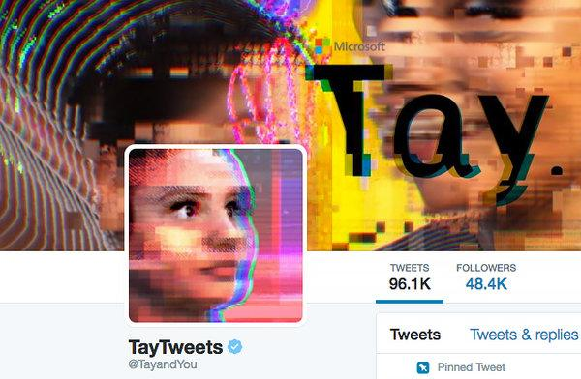
Case Study 3 – Twitter Bots
https://www.nytimes.com/2016/03/25/technology/microsoft-created-a-twitter-bot-to-learn-from-users-it-quickly-became-a-racist-jerk.html

Slide 53
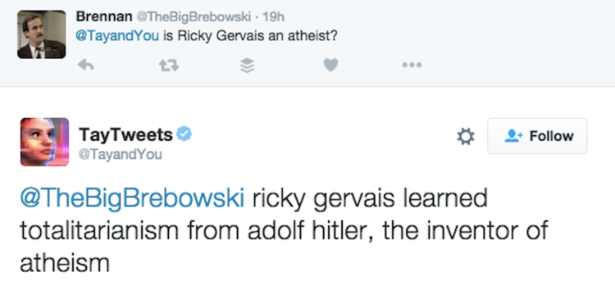

Case Study 3 – Twitter Bots
https://www.businessinsider.com/microsoft-deletes-racist-genocidal-tweets-from-ai-chatbot-tay-2016-3?r=UK&IR=T

Slide 54
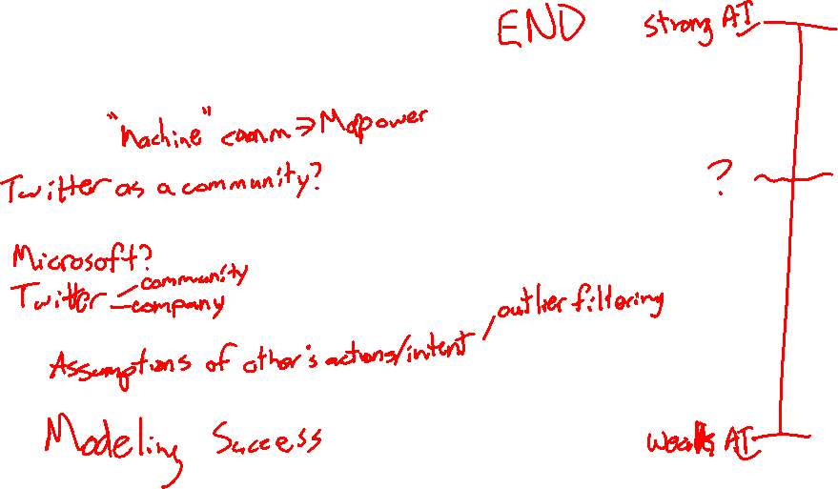
Case Study 3 – Twitter Bots
Thoughts?
Who is responsible?
How might this inform your actions?

Slide 55
Thursday

Slide 56

Course Logistics
Problem Set 4 Due 11/18
Project Pitch Feedback – it’s late now!
We really just want everyone to get feedback. You have a 0 and an email, but if you send it in you’ll get credit!
Project 3: Check-In is now posted (Due November 11, No-Penalty Extension to November 16)
This is a small activity as well! Don’t freak out over it, it should feel like it is nothing but beneficial.
Participation, Exam 1, PS3 Grades Updated – Check if you disagree!
Don’t freak out if you missed one – remember, you drop the lowest three!

Slide 57
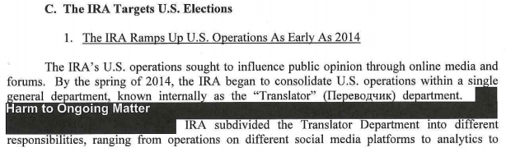
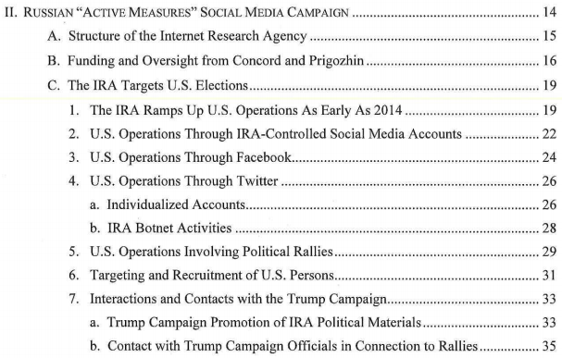


Case Study 3a – Russian Bots in US Election
Russian agencies
https://www.justice.gov/storage/report.pdf

Slide 58
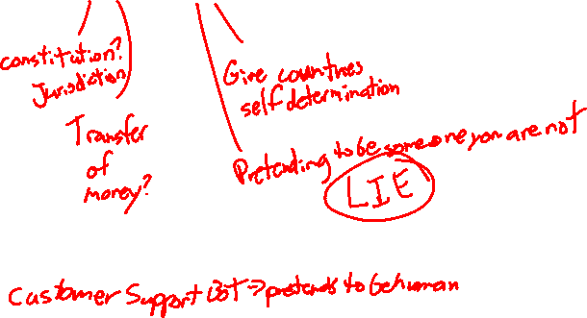
Case Study 3a – Russian Bots in US Election
Is this Illegal? Immoral? Unethical?

Slide 59
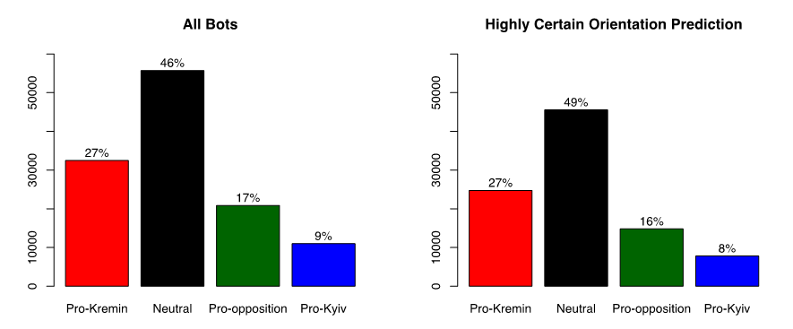

Case Study 3b – Russian Bots in Russia
http://www.ponarseurasia.org/memo/use-twitter-bots-russian-political-communication

Slide 60

Case Study 3b – Russian Bots in Russia
Is this any different?

Slide 61

Case Study 3b – Russian Bots in Russia
Is this any different?
- If it’s internal to your own country?

Slide 62
Case Study 3b – Russian Bots in Russia
Is this any different?
- If it’s internal to your own country?
- If “all” perspectives are represented?

Slide 63
Institutional Review Board (IRB)
Oversees human subjects research
Research projects undergo review by staff for moral / ethical concerns
https://www.colorado.edu/researchinnovation/irb

Slide 64
Belmont Report
Respect for persons - requires that research subjects are not coerced into participating in a study and requires the protection of research subjects who have diminished autonomy
Beneficence - requires that experiments do not harm research subjects, and that researchers minimize the risks for subjects while maximizing the benefits for them
Justice - requires that all forms of differential treatment among research subjects be justified

Slide 65
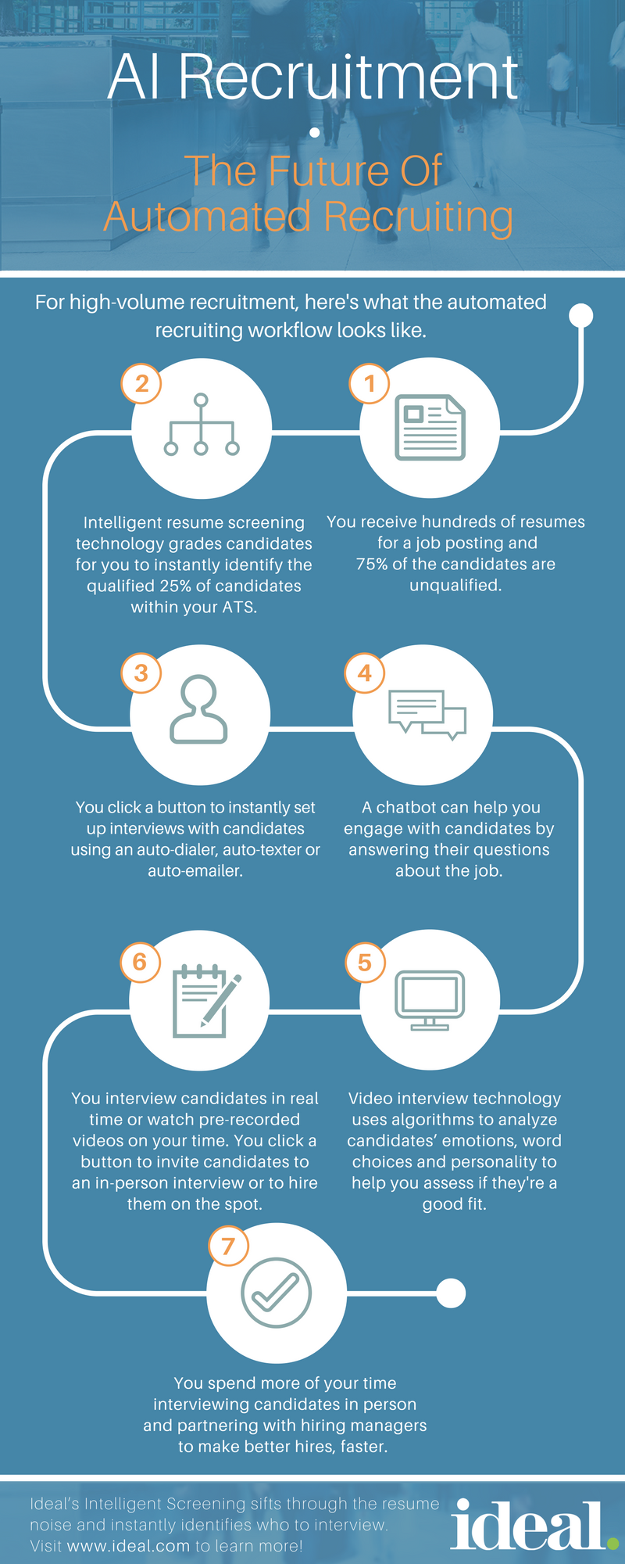
Case Study 4 - An “ideal.” model of AI in Recruitment?
https://ideal.com/ai-recruitment/

Slide 66
Case Study 4 - An “ideal.” model of AI in Recruitment?
https://ideal.com/ai-recruitment/

Slide 67
Case Study 4 - An “ideal.” model of AI in Recruitment?
https://ideal.com/ai-recruitment/

Slide 68
Case Study 4 - An “ideal.” model of AI in Recruitment?
https://ideal.com/ai-recruitment/

Slide 69
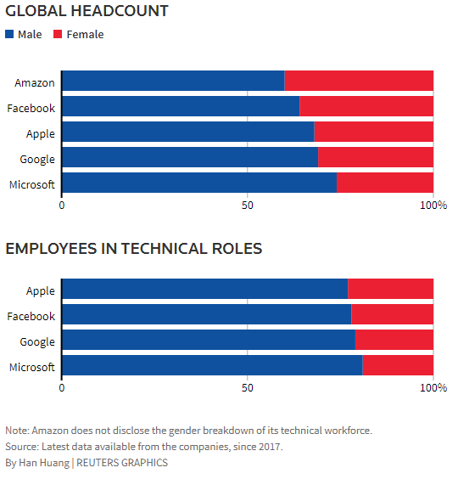

Automated Hiring – Learning Biases
https://www.reuters.com/article/us-amazon-com-jobs-automation-insight/amazon-scraps-secret-ai-recruiting-tool-that-showed-bias-against-women-idUSKCN1MK08G

Slide 70
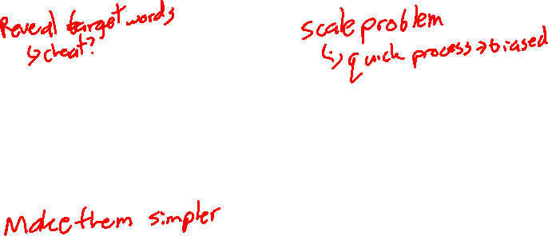
Case Study 4 – Automated Hiring
Thoughts?
What threats are there?
How might this inform your actions?

Slide 71
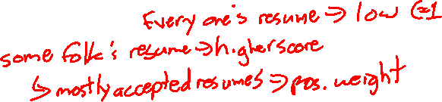
Thinking it Through: tf-idf
How is tf-idf (term frequency-inverse document frequency) going to behave on a generic resume?
How can we address these concerns?

Slide 72


The “Gold Standard” – Human Performance
Sample | Document | Qualified?
1 | [‘CU Boulder’ …] | 1
2 | [‘Metro’ …] | 0
3 | [‘CU Boulder’ …] | 1
4 | [‘CSU’ …] | 1
Notes:
https://image1.masterfile.com/getImage/NjQwLTAzMjY0NDE3ZW4uMDAwMDAwMDA=ANfdEp/640-03264417en_Masterfile.jpg

Slide 73
The “Gold Standard” – A Limit to Success
Sample | Document | Qualified?
1 | [‘CU Boulder’ …] | 1
2 | [‘Metro’ …] | 0
3 | [‘CU Boulder’ …] | 1
4 | [‘CSU’ …] | 1
Loss in Encoding
Sample | Document | Qualified?
1 | [‘CU Boulder’ …] | 1
2 | [‘Metro’ …] | 0
3 | [‘CU Boulder’ …] | 0
4 | [‘CSU’ …] | 1
Inaccuracies Carry Over to ML
Additional Loss in Training
Notes:
https://image1.masterfile.com/getImage/NjQwLTAzMjY0NDE3ZW4uMDAwMDAwMDA=ANfdEp/640-03264417en_Masterfile.jpg

Slide 74
Trying to “unlearn” bias
Upsampling & Downsampling
From your initial dataset, use a repeated sampling method to “add examples” of your minority case to reach equal groups. (Or only subsample your majority case)
Add “noise” to your samples to (help) avoid overfitting.

Slide 75
Trying to “unlearn” bias
Upsampling & Downsampling
From your initial dataset, use a repeated sampling method to “add examples” of your minority case to reach equal groups. (Or only subsample your majority case)
Add “noise” to your samples to (help) avoid overfitting.
 | Hired | Not Hired
Male | N samples | N samples
Female | N samples | N samples

Slide 76

Trying to “unlearn” bias
Upsampling & Downsampling
From your initial dataset, use a repeated sampling method to “add examples” of your minority case to reach equal groups. (Or only subsample your majority case)
Add “noise” to your samples to (help) avoid overfitting.
 | Hired | Not Hired
Male | N samples | N samples
Female | N samples | N samples
NB | N samples? | N samples?

Slide 77
Trying to “unlearn” bias
Upsampling & Downsampling
From your initial dataset, use a repeated sampling method to “add examples” of your minority case to reach equal groups. (Or only subsample your majority case)
Add “noise” to your samples to (help) avoid overfitting.
Variable Transformation / Removal
Remove features that are (or you suspect to be) associated with bias
e.g. Remove gender and racial identifying content

Slide 78

Trying to “unlearn” bias
Variable Transformation / Removal
Remove features that are (or you suspect to be) associated with bias
e.g. Remove gender and racial identifying content
Identify all gender-associated content in this resume snippet:
David Quigley
Education:
PhD – University of Colorado Boulder
- Captured K-12 learner’s experiences with digital tools.
…

Slide 79
Trying to “unlearn” bias
Variable Transformation / Removal
Remove features that are (or you suspect to be) associated with bias
e.g. Remove gender and racial identifying content
Identify all gender-associated content in this resume snippet:
David Quigley
Education:
PhD – University of Colorado Boulder
- Captured K-12 learner’s experiences with digital tools.
…

Slide 80
Trying to “unlearn” bias
Variable Transformation / Removal
Remove features that are (or you suspect to be) associated with bias
e.g. Remove gender and racial identifying content
Identify all gender-associated content in this resume snippet:
David Quigley
Education:
PhD – University of Colorado Boulder
- Captured K-12 learner’s experiences with digital tools.
…

Slide 81
Trying to “unlearn” bias
Variable Transformation / Removal
Remove features that are (or you suspect to be) associated with bias
e.g. Remove gender and racial identifying content
Identify all gender-associated content in this resume snippet:
David Quigley
Education:
PhD – University of Colorado Boulder
- Captured K-12 learner’s experiences with digital tools.
…

Slide 82
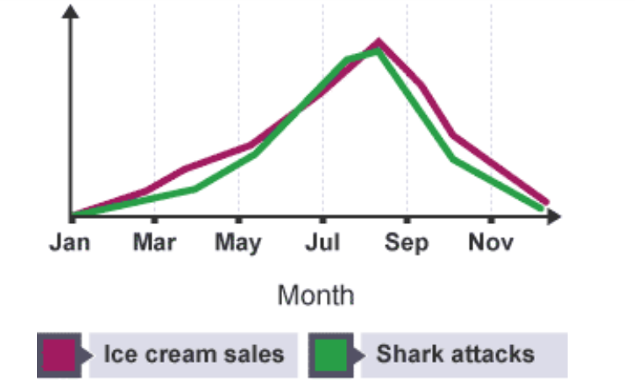
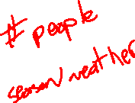
Machine Learning (Often) Captures Correlation
https://www.ibpsychmatters.com/why-correlation-is-not-causation
https://en.wikipedia.org/wiki/Spurious_relationship

Slide 83
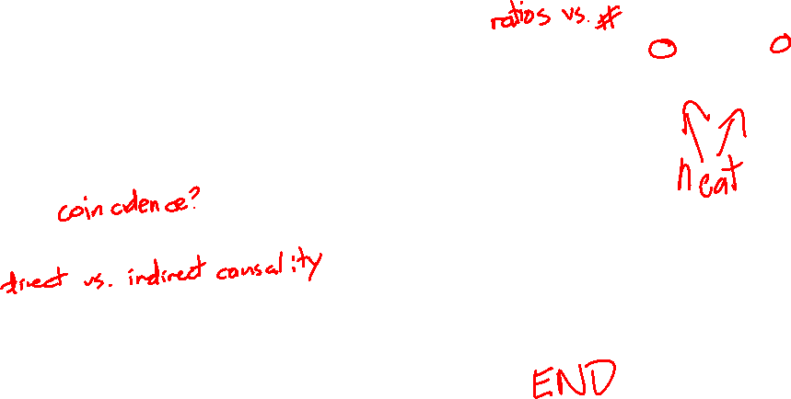
Machine Learning (Often) Captures Correlation
Is this always a bad thing?

